Slide 1
Cattle Breeding in Germany
Bianca Lind
German Cattle Breeders‘ Federation
German Beef Cattle Breeders‘ Federation
Bonn, Germany

Slide 2
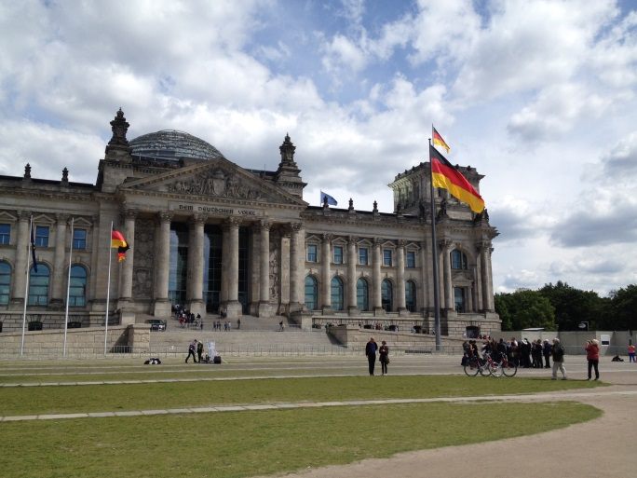
Welcome to Germany!

Slide 3
Animal husbandry is the main source of income
in Germany half of the farms are specialised in livestock
main group (> 25 %) are dairy farmer
through the sale of products from livestock enterprises, 60 % of revenues in German agriculture are generated
Federal Ministry of Food and Agriculture, 2010

Slide 4
Cattle stock in Germany
2010
Cattle per 100 ha agricultural area
Main areas for cattle management in Germany
Lower Saxony
North Rhine-Westphalia
Bavaria
0 – 30
30 – 60
60 – 90
90 – 120
120 and more
No information available
Federal Statistical Office, 2011

Slide 5
Cattle production in Germany
12.5 million cattle
4.2 million dairy cows
700.000 other cows
Federal Statistical Office, 2013

Slide 6
Structural change in dairy industry
161.500 cattle farms in 2013
12.5 million cattle in 2013

Slide 7
64.000 animals in beef breeds
Dairy cows |  | 4.2 million
Monthly recorded cows (DHI) |  | 3.6 million
Herdbook cattle |  | 2.7 million
Holstein | 1.780.000
Fleckvieh/Simmental | 718.000
Brown Swiss | 149.000
Rare Breeds | 18.000
Beef Breeds | 64.000

Slide 8
Galloways in Germany
Around 4.000 Galloway breeding animals
Characteristics of the breed
Calm
Reproductive
Long lasting
Tolerant
Resistant
Polled

Slide 9
One breed – different colours
BDF breeding objective
One colour
White
Belted
Rigget

Slide 10
Different code for breeds
ADR code for breeds (Rasseschlüssel)
Galloway
Belted Galloway
White Galloway

Slide 11
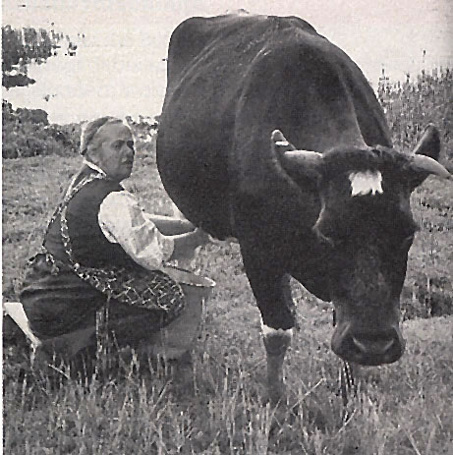
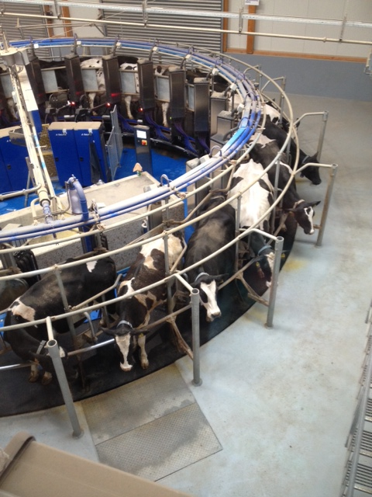
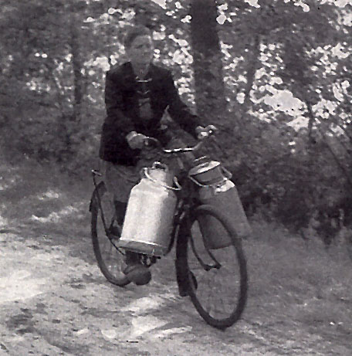
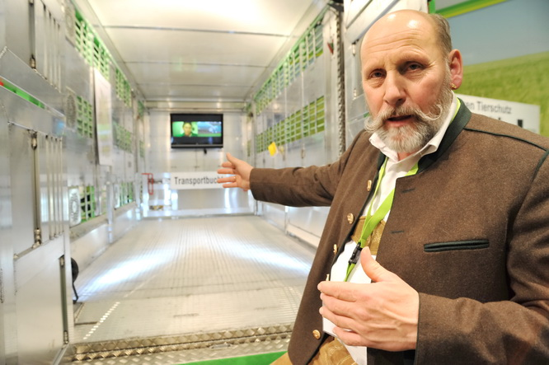
Future demands
animal health
animal welfare
market situation
structural changes
political conditions
consumer demands

Slide 12
Future demands
Size of population
Economical benefit
Image of beef
Sustainable production
Political conditions
Preservation of cultural heritage

Slide 13
Thank you for your attention.
Size of population
Economical benefit
Image of beef
Sustainable production
political conditions
Preservation of cultural heritage

